Slide 1

Auditing Strategy
Allen, Anna, Kobi, Sanjana
Notes:
Intro- Anna
Hi everyone, today we will be presenting our work for Summer Project #3 Auditing Strategy, having met more than 7 meetings over the course of the summer.

Slide 2
Mission
Curate new and improved auditing strategy
Create a new Deputy Auditor application
Decide on criteria for who to audit and when
Notes:
Allen

Slide 3
Why RUSA Allocations Audits Clubs
The money used is students’ money
Student orgs must use money as they requested
Build relationships with clubs and serve as a vital resource
Discuss ways to help them during the audit
Find ways to improve our own process
Notes:
Allen (points 1 and 2)/Anna (point 3)
Give one example for sub-bullet under each
Bullet Point 3 - RUSA Allocations also audits clubs to build an ongoing relationship with the clubs that they fund in addition to being a vital resource; through the auditing process, the Allocations Board can connect with the clubs and discuss ways to help them during the audit period by offering insights, giving clarifications, redirecting them to resources, etc. In addition, the Allocations Board can also find ways to improve our internal processes as well when we are discussing with clubs

Slide 4
2020-2021 Auditing Reflection
First time auditing clubs after almost a year
Revamped strategy
Implemented Deputy Auditors
Many resources created for future Auditors
Found out more about eboard structure through auditing
Notes:
Sanjana

Slide 5
Deputy Auditor Reflection 2020-2021
More importance on who becomes a Deputy Auditor than how many there are
Role is critical in improving auditing process and a key part of auditing a larger amount of clubs
Clubs were hesitant about the process and the reason for the audit
Often clubs had lingering questions but hesitated to reach out to the Allocations Board
Notes:
Sanjana/Anna
Anna - I found my role as a Deputy Auditor in the Allocations Board to be immensely-rewarding and insightful. I got to learn much more in depth about the allocations process within RUSA and the intensity of the work that is being performed and also about working in a collaborative, team-based environment. Mostly all of the clubs that were audited were prepared and supportive. I felt that clubs and their executive teams were more hesitant and apprehensive about the auditing process and the reason why they were being audited. We would let them know that their club was randomly chosen to be audited for the week, the club members at-times seemed suspicious so we can create more awareness to this process and why we perform the auditing process. In addition, clubs sometimes had lingering questions about funding and budgets but I felt that they were apprehensive about reaching out and asking questions directly to the Board so this can also be an area where we can raise awareness during training of the clubs

Slide 6
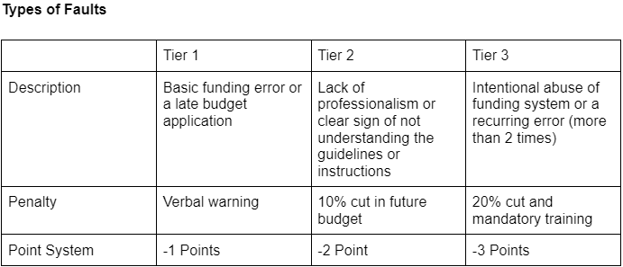
Old Audit Strategy New Audit Strategy
Singular, Virtual audit that consisted of an Intake Form and Virtual Meeting
Random selection of clubs to Audit from all organizations on campus
Rehabilitation through virtual meeting and discussion
Total audit of around 40 clubs across 2 semesters
Est. increase to 50-60 per semester
Clubs were not very responsive to messages and emails
Required response dates and Phone call as final measure
2 Options of Audit; Virtual (General Audit) and In-Person (Deep Audit)
Random selection of Virtual Audits and selection from priority clubs for In-Depth Audit
Tier system for types of faults that organizations conduct, each impacting the priority of the club for future audits
Notes:
Kobi

Slide 7
Deputy Auditors: What we’re looking for
Looking for 4-5 Deputy Auditors
As of 9/13 we have 7 Applicants (Form closes 9/20 @ 5PM)
Interviews will be held the week of 9/20 ~ 9/24
2 Training sessions
Session 1 - 9/27
Session 2 - 9/28
Notes:
Kobi
Invite: Advisors (Lori and Laura), All Allocations Board Members, RUSA Treasurer/President

Slide 8
Looking forward
More importance on the auditing criteria
Implement Deputy Auditor recruitment into main recruitment
Auditing help nights
Notes:
Sanjana/ Kobi

Slide 9
Resources
2020-2021 Auditor Folder
GetInvolved
Applications
Notes:
Sanjana/ Whoever

Slide 10
Takeaways/ Summary
The deputy auditor form/recruitment process is under way with a healthy amount of applicants!
Introduction of new auditing system for easier meeting with treasurers and a punishment system for misconduct
Notes:
Allen/Anna
Add a summary bullet point

Slide 11
Questions?

